Slide 1
2001 Gujarat Earthquake
By:
When: January 26th 2001 , at 08:46 am Indian time
Where: Bhuj town in the Indian State of Gujarat on the Pakistan border
What: Thrust fault occurring at shallow depths and push between the Indian plate and Eurasian plate
Notes:
The Gujarat earthquake occurred 8:46 Hrs indian time, in January 26th 2001, it is also referred to as Bhuj earthquake because it had occurred near the Bhuj town where many families and properties of unknown values were destroyed
The state of Gujarat is bordering Pakistan, the villages and towns on the boarder were greatly affected by the earthquake, the vibration movement reached the boarder where the Pakistan is located just on those villages and town nearby, the state of Gujarat is near the Pakistan and the disaster could have speared them
The faulting among the rocks is the result of earthquake, for the Gujarat earthquake, the faulting was happening at shallow depths resulting to up and down of the rocks
The Indian plate and Eurasian plate have been known to be the reason behind the Indonesian earthquakes which happens unaware, the behavior of the two plates have brought many questions to the scientists who would want to use all the possible ways to reduce the unaware occurrence

Slide 2
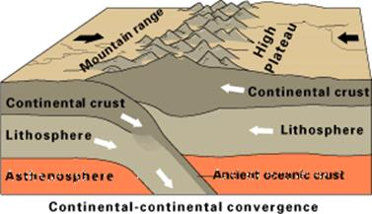
Tectonic Setting
The earthquake occurred within the tectonic thrust fault
The Indian plate was being pushed northwards towards the Eurasian plate
The North wagad reversed into a dip-slit causing the earthquake
Notes:
The main reason for the Gujarat earthquake was because of the Indian plate and the Eurasian plate imbalance, the plates cause the release of the seismic waves which then released the energy stored in the earth crust resulting to the earthquake
The downward and upward movement of the continental thrust also results in the production of energy from the earth crust which then result to an earthquake
The tectonic forces occurring on the rocks play a great role in contributing for the earthquakes and strong forces beneath the earth, the strong forces and uncontrollable since they have great energy and occur at a very short period during its final stages
When the forces have been exacted on the rocks, the forces gain more energy and need of getting out from the ground is created, the forces vibrates the earth and the process large part of the earth cracks destroying properties, cities and taking lives
Upward and downward movement result to vertical displacement on the continental thrust and the lethosphere

Slide 3
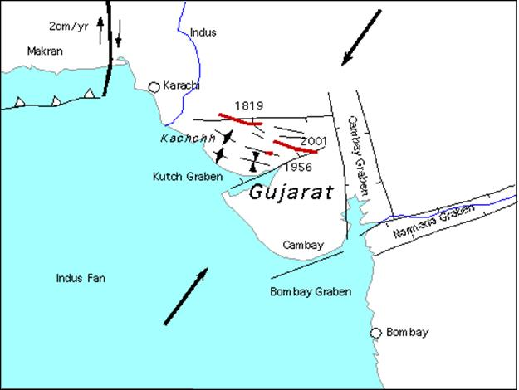
The setting was off the coast of the state of Gujarat
It occurred near the town of Bhuj, close to kutch garden and the Bom bay garden and near the Arabian sea
The setting of the Gujarat earthquake is between the Indian plate and the Eurasian plate
Caused by the thrust fault of the two plates.
The fault then cause the upwards and downward movement of the continental thrust
Geologic setting
Notes:
The Gujarat state is surrounded by the water body, and because faulting reaction was happening on the rocks it happened off the coast, it wasn’t germinated by the tsunami even though those generated by Tsunami also occur on the coastal off shore
The region where the earthquake occurred is surrounded by the kutch garden and the Bom bay garden on the Arabian sea, during this time many people were on this gardens and many died as the water was forced to raise with high forcing killing many and few survivors
The boarder of the Gujarat state was the Pakistan communities who were living there and some were working in the Gujarat state, some were affected in Gujarat state while some were affected in their villages in Pakistan
The Arabian sea having many activities claimed many lives, the vibration caused the water to move with a high speed from its place to the land sweeping away many people dangerously and destroying their shelters

Slide 4
Geologic Hazard
MW=7.7
Gujarat has been experiencing earthquakes 9 times for the last 200 years.
The Indo-Australian plate over the centuries slides over the Eurasian plate causing fault line beneath.
On 26th January 2001, the south-dip fault that was trending parallel to the rift structures moved pushing the two plates.
The thrust fault produced energy in joules (1.12 x10^17) which made the earth to vibrate for some few minutes.
The vibration moved to kachchh, Ahmadabad, Surendranagar, Jamnagar and Rajkot districts
Sindhh the province of Pakistan also reported casualties
Liquefaction was the major contributor
There was massive destruction of properties and lose of lives of about 13805
Notes:
For the last 200 years the Gujarat state has been experiencing earthquakes but the 2001 earthquake was the largest and caused a lot of destructions
It began when the Indo-Australian plate started to slide on the Eurasian plate, the process causes faulting beneath the earth
On 26th January 2001, the forces on the rock became too strong and the vibration made the rocks the explore cracking the many parts of the Gujarat state and this was accompanied by strong energy from the earth crust resulting from the seismic waves
The nearby districts were damaged and many people who died were from the the five districts that were surrounding the Gujarat state
Liquefaction and tectonic forces was the major contributor of the earthquake which claimed life of more the 13805 people and 40 people in the neighboring Pakistan
Apart from the people who lost their lives many of the families remained disabled and unable to work properly to feed the families
The city was completely destroyed since all the buildings collapsed many institutions were destroyed affecting learning in many parts of the state

Slide 5
Conclusion
Four months after the earthquake the government set aside 1.77 billion dollars to restore the situation
Government has placed the early warning indicators of earthquakes
The affected region and communities were educated on early response and early evacuation
International emergency response team and the government merged to work together in disaster risk management
The government has also set aside money that will sustain the economy and the people incase of the reoccurrence
Notes:
There were restoration plans for the state from other government and its own government, the release of 1.77 billion dollars enabled the government to plan for immediate response of housing, water, and food.
The government in collaboration with other international government have design early alerts of earthquakes in the state to control future reoccurrence to prevent damages and loss of life.
The early evacuation plans and response to the earthquake included the education of the community on how to get ready for evacuation incase of an alarm from the government or science department
The money set aside by the government is for making the community stable after the disaster and stabilize the economy
The State also received help from Countries such Australia and Belgium, among many other countries. The donations from the two countries greatly supported the families and small businesses after the disaster
The government build temporary homes for the community, they were also supplemented with clothing and enough foods from many other countries.
Indonesian reoccurrence of earthquake caught the global attention and it received earthquake detectors for early warnings from varied scientists to reduce loses and deaths in near future

Slide 6
References
https://link.springer.com/article/10.1007/s11069-012-0182-9
http://gsdma.org/Content/earthquake-4219
https://www.arcgis.com/apps/MapJournal/index.html?appid=09e247726f3b469ba52ec79874bf2a83
https://www.researchgate.net/figure/Epicentres-of-earthquakes-M-C-20-occurred-in-the-Gujarat-region-during-the-period_fig1_257632646
https://journals.sagepub.com/doi/abs/10.1193/1.2803903?journalCode=eqsa
https://www.britannica.com/event/Bhuj-earthquake-of-2001

